Slide 1
JavaScript
Creativity & Computation Lab
Week 1

Slide 2
Hello!
Jaskirat R.
MFA DT ‘16
jaskiratr@newschool.edu

Slide 3
Syllabus

Slide 4

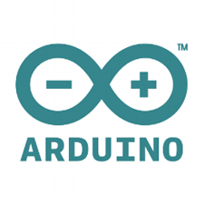


JavaScript
Arduino
Unity
openFrameworks

Slide 5
NOT related to Java (although some similarities exist)
Lightweight, interpreted programming language.
Object-oriented, prototype-based
Most well-known as scripting language for web pages
JS is built into web browsers
Useful for its ability to access and programmatically manipulate the elements in HTML/CSS, adding interactivity to web pages
Notes:
Note: not JUST for web pages

Slide 6
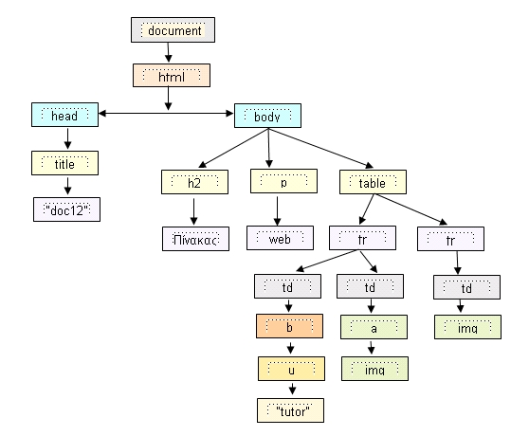
JavaScript and the DOM
DOM: Document Object Model
The DOM provides a way to represent, store, and manipulate the web page elements as objects (represented as a tree or node structure). JavaScript can call these objects and programmatically alter anything that is written in the HTML document.

Slide 7
Variables
Variables are containers for storing data values. Variables can be booleans, numbers, strings, arrays*, objects. Variable names must begin with a letter, $, or _. Variable names are case sensitive.
// all variables in JS are declared with var
var num = 3;
var _name = “hello”;
var excited2BeHere = true;
var count = [0,1,2,3];
Notes:
*arrays are technically a special type of object

Slide 8
IMPORTANT Sublime Text Package Control Google Chrome/Firefox Github Accounts Terminal (Mac) / Cmder (Win) Spectacle App (Mac)

Slide 9
Functions
A function is a set of statements that performs a task.
// to define a function, you need a function name, parameters inside the parentheses ( ), and statements inside the curly brackets { }
function addingNumbers (num1, num2) { return num1 + num2; }
// for the function to execute, it needs to be called somewhere else in the code.
addingNumbers(1,2);

Slide 10
Objects
Objects can contain many values Written with curly braces { }, with object properties written in name:value pairs and separated by commas
var student = {firstName: “Sven”, lastName: “Travis”, height: 900};

Slide 11
Arrays
//Arrays store multiple values in one variable (like objects!)
var animals = [“rabbit”, “cat”, “hamster”];
//Arrays in JS can contain varied data types
var thingsILike = [“cookies”, 2, “bunny”];
//Arrays can even contain objects and other arrays!
var student = {firstName: “Sven”, lastName: “Travis”, height: 900};
var myArray = [student, thingsILike];

Slide 12
Array Methods
toString() join() push() pop() shift() unshift() splice() concat() slice() valueOf() sort()
Notes:
Open up sublime text and demonstrate using all of these!

Slide 13
Exercise 1: JS loading animation
Start by creating your html and css files
Notes:
Html , css, and JS live code example included in folder

Slide 14

Homework:
Use JavaScript to create an interactive list on your webpage.
Album of the week:
http://bit.ly/2bS7PEM

